Slide 1
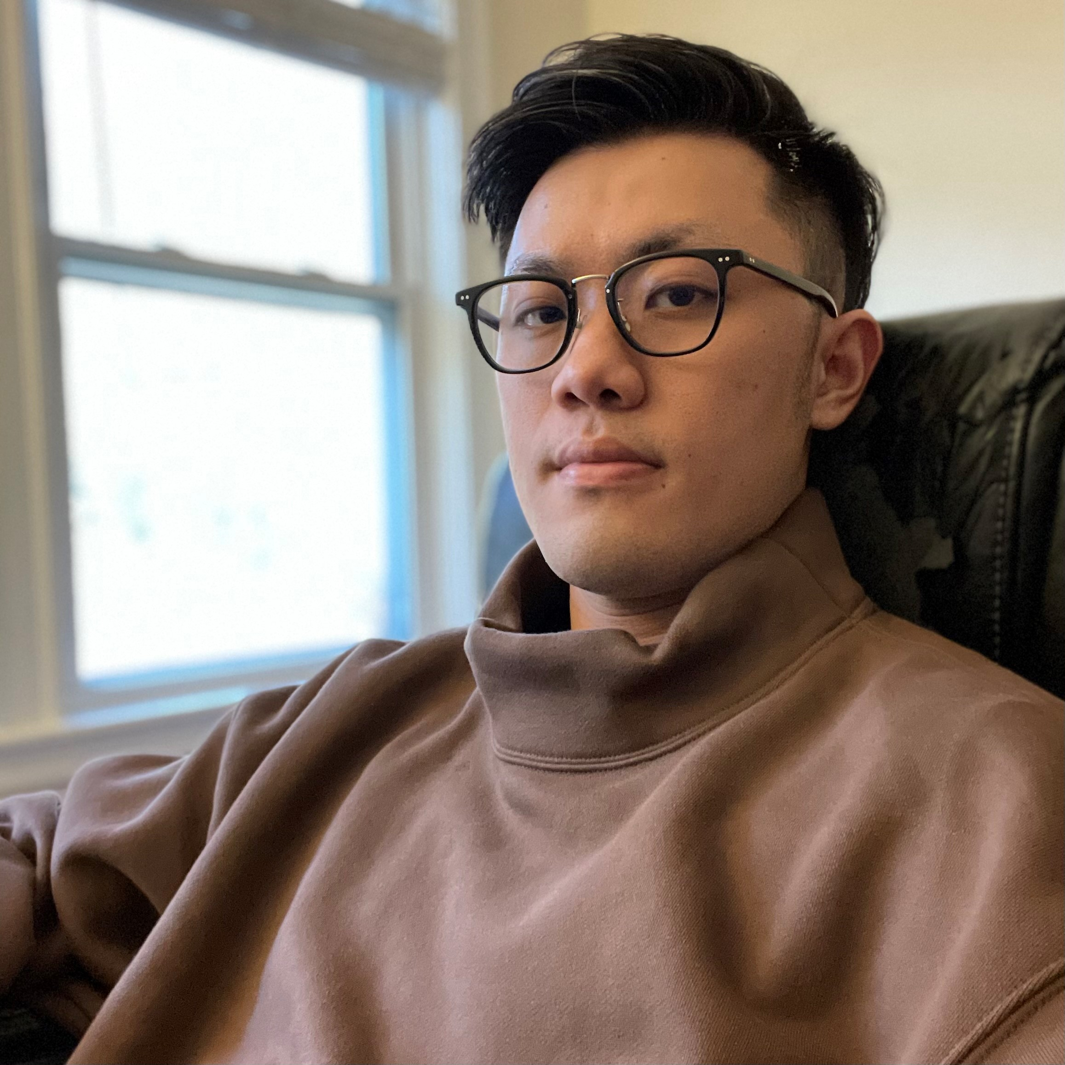
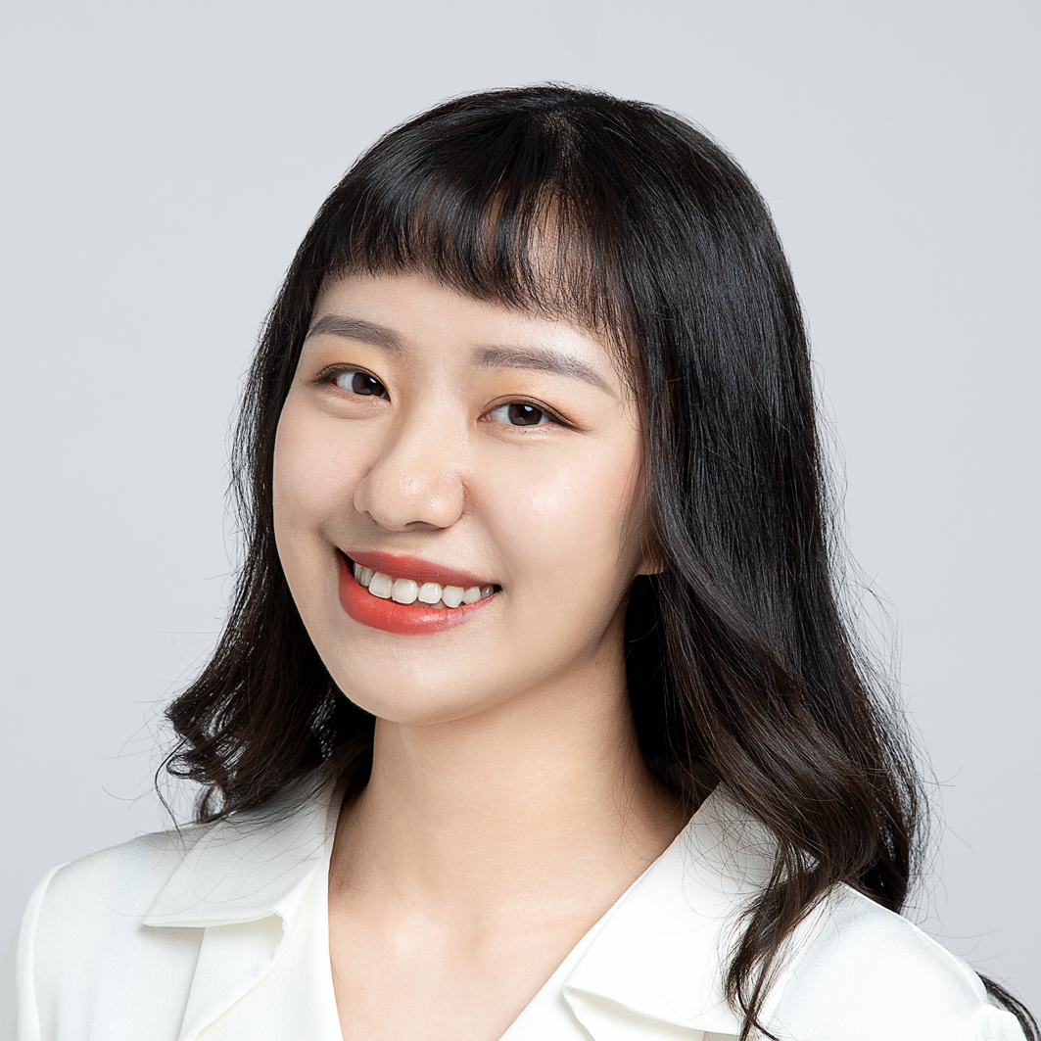
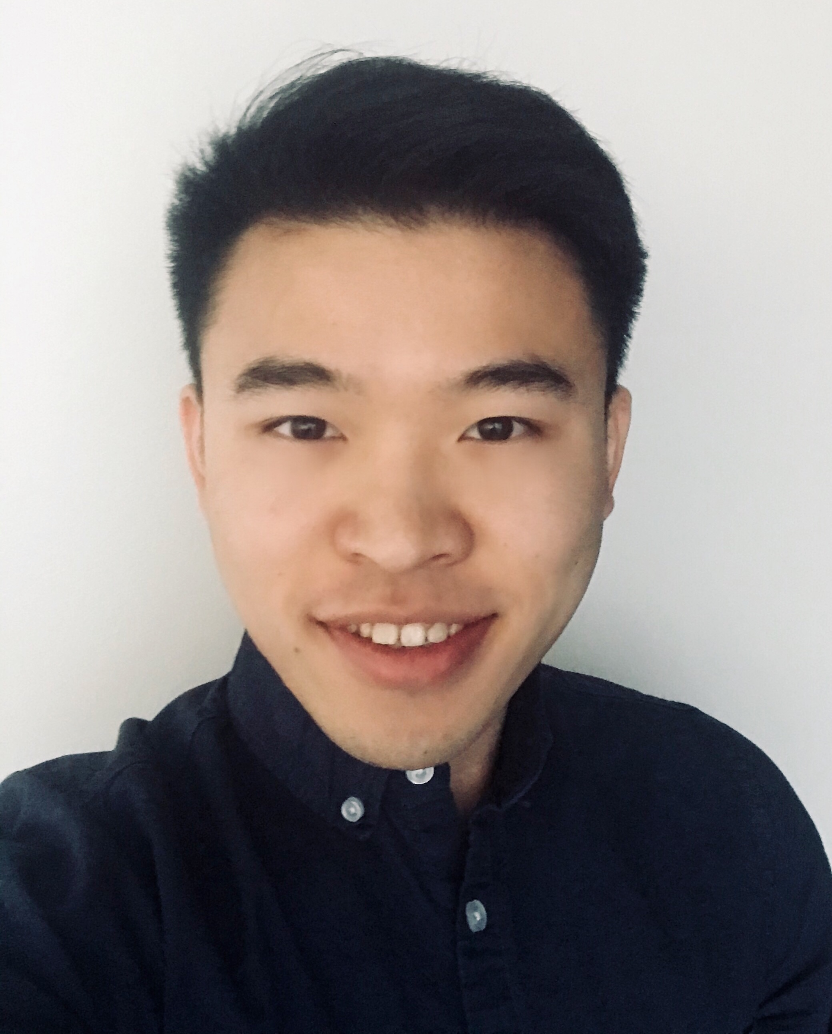
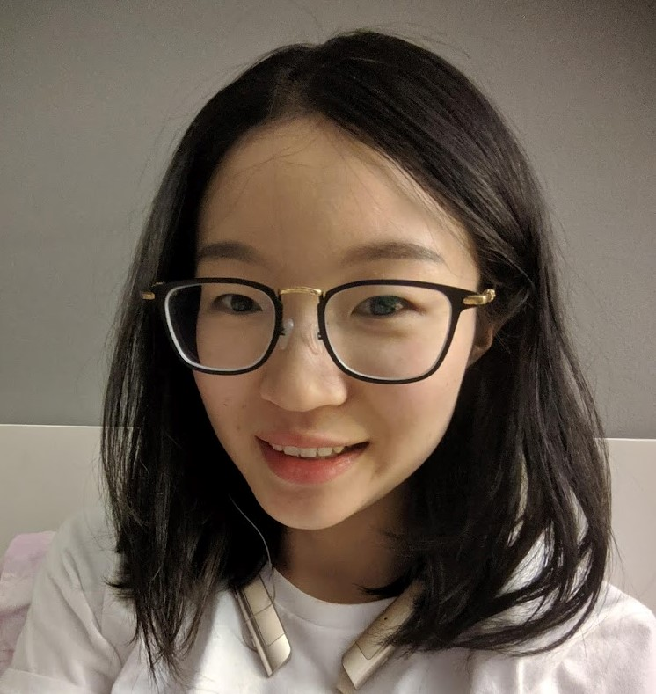
Team 12
Chen Ling
MSBA
Bentley University
Han Wu
MSBA
Bentley University
Jianyi Liao
MSBA
Bentley University
Xiaoshuang Liu
MSBA
Bentley University
Notes:
Instructions:
First download this file
Change the team number at the top.
Right click on the circle, select “Format Shape”. On the right box, go to “Shape Options”, then select “fill”, then select “Picture or texture fill”. Then under “insert picture from“ select “file” to upload the picture of the team members.
Under the image, write “name and surname”, ”program”, and “college” for all the team members.

